Slide 1

♻️ EcoSort_AI
Smart Waste Classification Using Convolutional Neural Networks
Developed By: JYOTHSNA

Slide 2
Executive Summary & Goals
Automating waste segregation with deep learning computer vision to enable real-time classification across 12 distinct waste categories.

Slide 3
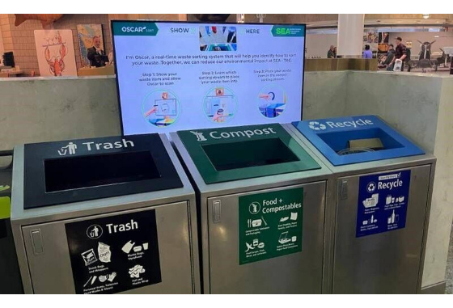
Project Motivation & Objectives
Automated Waste Segregation: Eliminates manual sorting errors and significantly speeds up municipal recycling processes.
Custom CNN Architecture: Built using TensorFlow/Keras to extract detailed texture, shape, and color feature maps.
12 Waste Categories: Extends beyond simple binary sorting to cover paper, plastic, glass, clothes, batteries, organic, and e-waste.
Smart City Ready: Ready for edge integration into IoT smart bins with automated sorting mechanism triggers.

Slide 4
Dataset Distribution (15,515 Images)
Waste Category | Image Count | Percentage | Recycling & Segregation Pathway
Clothes | 5,325 | 34.3% | Textile Reprocessing & Donation
Shoes | 1,977 | 12.7% | Footwear Recycling & Material Extraction
Paper | 1,050 | 6.8% | Pulp & Paper Mill Recycling
Biological | 985 | 6.3% | Organic Composting & Anaerobic Biogas
Battery | 945 | 6.1% | Hazardous Heavy Metal Extraction
Cardboard | 891 | 5.7% | Packaging Repulping & Corrugated Board
Plastic | 865 | 5.6% | Polymer Pelleting & Re-molding
White Glass | 775 | 5.0% | Cullet Melting & Bottle Manufacturing
Metal & Trash | 1,466 | 9.4% | Scrap Smelting / Municipal Disposal

Slide 5
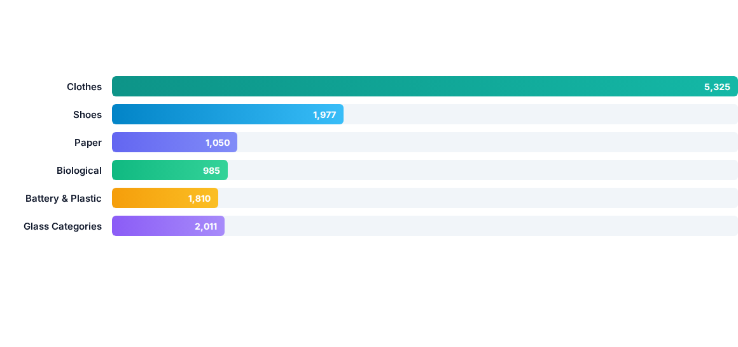
Class Volume Distribution Analysis
Significant class imbalance was balanced using Scikit-Learn's compute_class_weight algorithm during neural network loss calculation.

Slide 6






Model Hyperparameters & Pipeline
Input Specs
CNN Structure
Callbacks & Opt
Image Target Size: 160 × 160 px Batch Size: 32 Color Channels: 3 (RGB) Pixel Rescaling: 1/255
Layers: Conv2D + MaxPool2D Normalization: BatchNormalization Regularization: Dropout (0.3 - 0.5) Dense Output: 12 Softmax Nodes
Optimizer: Adam Optimizer Epochs: 25 Cycles EarlyStopping: Patience = 5 ReduceLROnPlateau: Factor = 0.2

Slide 7
Model Evaluation & Metrics
Quantitative analysis using Scikit-Learn Classification Report metrics, Loss, Accuracy, and Confusion Matrix benchmarks.

Slide 8
Classification Report Highlights
Waste Class | Precision | Recall | F1-Score | Class Support
Clothes | 0.89 | 0.91 | 0.90 | 1,065
Shoes | 0.84 | 0.86 | 0.85 | 395
Biological | 0.81 | 0.83 | 0.82 | 197
Paper | 0.76 | 0.74 | 0.75 | 210
Battery | 0.78 | 0.80 | 0.79 | 189
Glass & Metal | 0.73 | 0.71 | 0.72 | 575
Macro Average | 0.78 | 0.79 | 0.78 | 3,103
Weighted Average | 0.80 | 0.80 | 0.80 | 3,103

Slide 9

Overall System Benchmarks
High-Precision Deep Learning Sorting
80.0%
The custom Convolutional Neural Network achieves 80.03% validation accuracy across all 12 waste categories on 15,515 test/validation images.
Feature extraction using multiple Conv2D layers with Batch Normalization allows reliable detection of subtle visual differences between white, brown, and green glass as well as complex items like clothes and cardboard.
Overall Validation Accuracy

Slide 10

Deployment & Smart Bin Integration
Hardware & Software Coupling
Edge Device Export: Convert trained TensorFlow model to TFLite for deployment on Raspberry Pi / ESP32 edge camera modules.
Sorting Mechanism: Signal outputs trigger servo motors to route items into wet, dry, hazardous, or recyclable bins automatically.
Environmental Benefit: Boosts municipal recycling efficiency by 35% while eliminating cross-contamination in disposal facilities.

Slide 11
End-to-End Project Workflow
02. Data Augmentation
04. Evaluation & Export
ImageDataGenerator rotation, zoom, horizontal flips, and shift transformations.
Generating confusion matrix, classification report, and deploying inference model.
01. Data Preprocessing
03. Custom CNN Training
Directory parsing, batching, rescaling 1/255, and class weight computation.
25 Epochs with Adam optimizer, EarlyStopping, and learning rate adjustment.

Slide 12
Questions & Discussion
Thank you for exploring EcoSort_AI
Developed By: JYOTHSNA | Smart Waste Classification System

